Slide 1
**Manually Fetch OAuth Token
Endpoint URL : Standard API
https://<hostname>:<port>/api/v1/MessageProcessingLogs
Token API URL :<TokenURL>
Client id : <clientid>
client secret : <client secret>
Call the above API endpoint by using OAuth Client Credentials in security material
Call the above API endpoint by calling OAuth manually and not using security Material

Slide 2
Day 1 Exercise
Create a sample package and Create a new IFlow
Pre Requisite Parameter: Use the Content Modifier to set message content using the Constant, XPath, and Expression source types. For each message flow, capture the modified message at runtime and store it in a local or global variable.
*Expressions*: ${header.name}
${property.name}
${in.body}
Expression for Date and time :
-------------------------------------------
Currentdate: 2022-03-22T15:08:43Z
Task:- -------
<Order_details>
<orders>
<Orderid>278</Orderid>
<ordername>Nickel</ordername>
<orderquantity>5</orderquantity>
<price>2000</price>
</orders>
</Order_details>
Result Should be:-
---------------
<Order_details>
<orders>
<productid>278</productid>
<productname>Nickel</productname>
<Amount>10000</Amount>
</orders>
</Order_details>

Slide 3

Day 2 Exercise
In this exercise, the data sent should be used for calculations according to the requirements
1. Create a new Calculator Iflow.
Requirements :
Use Mapping and Routing pallets and Soap adapter to call the below URL
URL : http://www.dneonline.com/calculator.asmx
Input : Expected Output:
<Input>
<Input1>2</Input1>
<Input2>1</Input2>
</Input>
Condition : Based on Header field “OperationType” we need to Add, Sub , Multiply,Divide
If value is Add then it should Add,
If value is Sub then it should subtract
If value is Multiply then it should Multiply
If value is Divide then it should Divide
Else default should “Invalid Operation selected”
<Output>
<Result>3</Result>
</Output>

Slide 4
Day 3 Exercise
This exercise covers the Number Range concept and the use of Groovy scripts for tasks such as payload logging and setting custom headers
Use Case:Calculate and maintain a sequential message number. Capture the payload as an attachment during processing and capture a custom header for payload identification during monitoring.
INPUT PAYLOAD
<Order_details>
<orders>
<Orderid>278</Orderid>
<ordername>Nickel</ordername>
<orderquantity>5</orderquantity>
<price>2000</price>
</orders>
</Order_details>
Pre Requisite parameters:
Content modifier with Number Range as source type
Logging and custom header groovy Scripts
Unique Field is Orderid

Slide 5
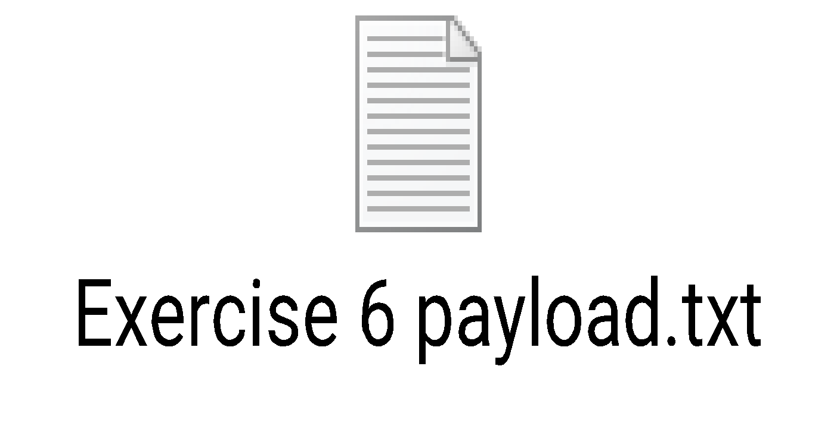
Day 4 Exercise
This exercise involves retrieving multiple plant information records, which will then be segregated based on zone.
Pre Requisites to use Timer, Content Modifier, Splitter and Router
Use case:
In this scenario, we will route messages to two different branches based on the zone. If the zone value is less than or equal to 4, the message will be sent to one branch. If the zone value is greater than 5, the message will be sent to the other branch.

Slide 6

Day 5 Exercise
Based on the incoming data, the status of each message (success or error) is determined. Filter the error and success messages to separate branches without using a conditional statement
Pre Requisite Parameters:
Postman, Https Adapter, Content Modifier, Parallel multicast and Filter
Use Case: Data will be routed based on its status. Successful data will be sent to one branch, and data with errors will be sent to a different branch by using filter option
Conditions:
CASE 1: Filter the incoming XML containing <ErrorNode>
CASE 2:
Filters the Record node which contains <Status> node with value S [ Success ] or SK [ Skipped ]

Slide 7
Day 6 Exercise
REQUIREMENT
For every process, authentication is very important, such as basic and OAuth (token-based) authentication. If we are using OAuth (token-based) authentication, and supposing the token has validity, then how do we capture the new token for the process once the old one expires
USE CASE:
In this process, we will retrieve OAuth details from another system, store them in a writable variable, and then use that variable in the required flow.
PRE REQUISE PARAMATERS:To obtain a bearer token using OAuth authentication, the token URL will be called directly, using the client ID and client secret as credentials. The Content-Modifier's header will be set with "Content-Type: application/x-www-form-urlencoded", and the body will include "grant_type = client_credentials". The Content Modifier's source type will be set to "Global Variable," and a datastore will be selected. Because the token response is in JSON format, a JSON to XML converter will be used. Finally, the endpoint of the target system will be used to connect and retrieve the required details

Slide 8
Day 7 Exercise
In this Exercise we will get the Country information and store the data in Data store
Requirement use the Timer Event, Data Store and SOAP Adapter
Use Case: In this scenario we will call a third-party SOAP based free web service to get the weather data of a city. Based on the fact whether we get the valid response or not, message routes to two different paths, one would be default and one for valid response. We also write the weather service response to Data Store and log the response as attachment as well. Schedule the interface to Run for every one hour.
Condition:- If it is a valid response data should write to datastore and log the payload as attachment and if else just log the payload as “no valid response found from web service”
INPUT PAYLOAD
<web:FullCountryInfo xmlns:web="http://www.oorsprong.org/websamples.countryinfo">
<web:sCountryISOCode>US</web:sCountryISOCode>
</web:FullCountryInfo>
Address:
http://webservices.oorsprong.org/websamples.countryinfo/CountryInfoService.wso

Slide 9
Day 8 Exercise
This exercise involves calling a standard SAP OData API service and handling success and failure messages separately, without using a filter
Use Case:-A timer will schedule calls to an OData API service to retrieve successful and failed messages from the CPI monitoring tab. A Router palette will then send these messages, formatted as tables (as shown below), to a mail adapter.
IFLOW | MESSAGE ID | STATUS
Open API Url :- https://tenant_Url/cpi/api/v1/MessageProcessingLogs
Authentication : Use Service instance api key in Cockpit

Slide 10
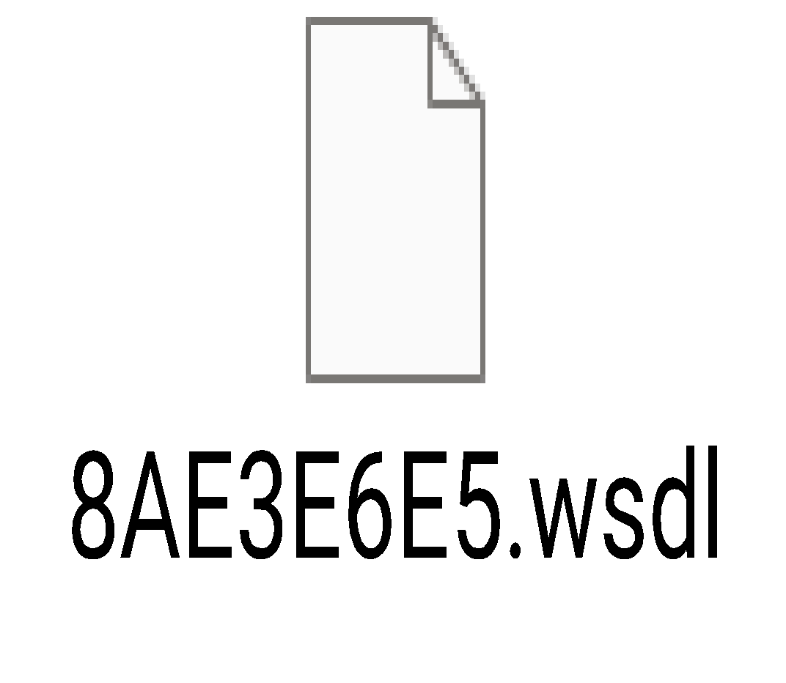
Day 9 Exercise
Income Tax department has an online portal which uses web services to expose data.
Use Case: Based on the fact if an end user is an Individual or a Department, data would be sent as CSV attachment in a mail for the Tax ID or PAN (Permanent Account Number) or to Insurance department as a file in JSON format for verification. In case, data should be sent to an individual, it must be filtered based on PAN, a user ID should be generated and mapped to the CSV structure before it is converted to CSV. For any other department, it should terminate.
Note:- All the required documents for this exercise will be provided by Instructor
SOURCE WSDL:
Pre Requisites parameter:
Content Modifier, Filter, Convertor, Message Mapping

Slide 11
Day 10 Exercise
Email to DropBox - Invoice Handling Interface
Use Case: We need to streamline and modernize our invoice processing operations .By automating the extraction of invoices from email attachments (PDF, XML and ZIP) and securely storing them in Dropbox, we aim to significantly reduce manual data entry, enhance accuracy, and expedite the accounts payable process. This integration not only improves efficiency but also ensures compliance with financial regulations while accommodating our global supplier network's diverse invoice formats. The inclusion of an error handling mechanism further minimizes the risk of overlooking invoices, allowing our finance team to maintain control and efficiency in handling incoming invoices, thereby supporting our organization's financial health and growth objectives
Authorization URL
https://www.dropbox.com/oauth2/authorize?token_access_type=offline
Token Service URL
https://api.dropboxapi.com/oauth2/token
DropBoxLogin
https://www.dropbox.com/
DropBox Developer Portal
https://www.dropbox.com/developers/apps
Pre Requisites :
iFlow Design, Development, Deployment and Testing
Palette Functions
Sender/Receiver Participants
Groovy Scripting
Exception Handling
Router
Adapters
Email
DropBox

